Slide 1
Getting to Delivery
It’s blinking, now what?

Slide 2



I’m hamster
electronics and con badge nerd
yes I’m glad girl scout cookie season is over

Slide 3
Overview
I finished my badge design!
Now how do I get a bunch of these made?
And how do I get them out to people?

Slide 4
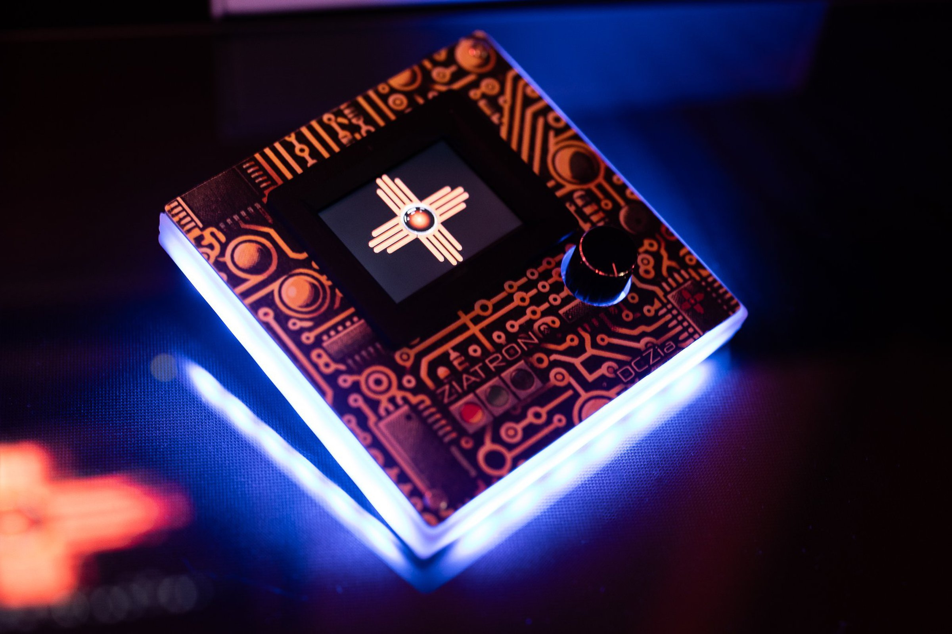
Design is complete
Go go gadget badge building

Slide 5
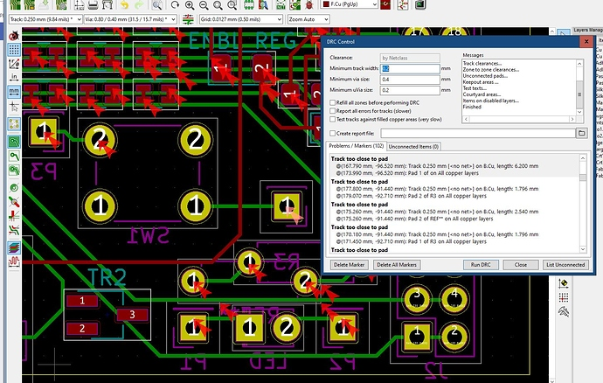
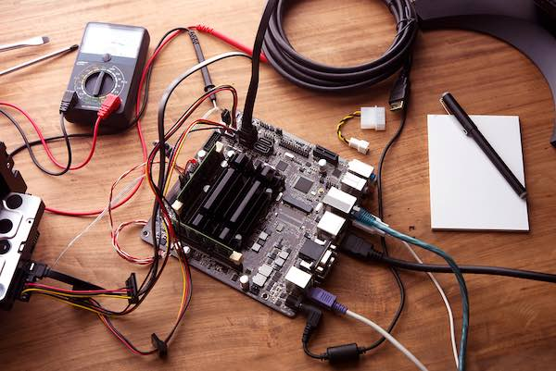


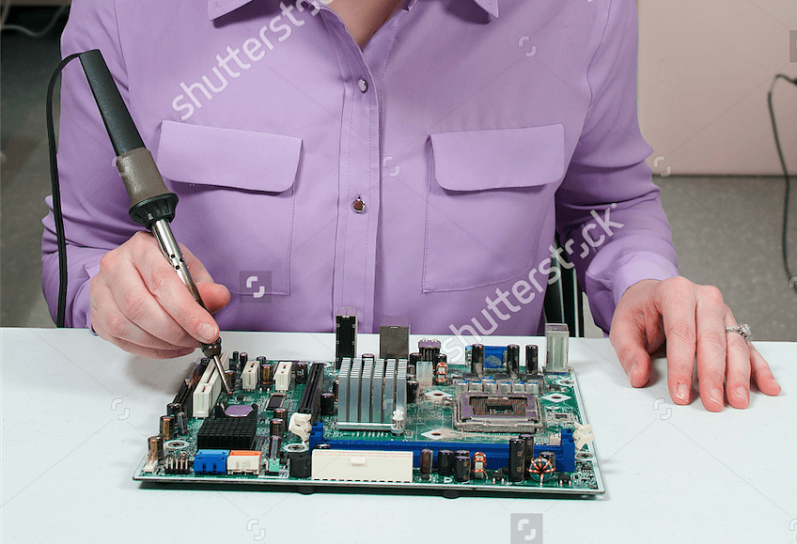
Pre-Production Checks!
Did you run ERC/DRC?
Did you make a prototype?
Can you actually build it?
Can you actually source all the parts?
Can you test/diagnose it?

Slide 6

DRC/ERC
Always run Design/Electrical Rules Check
Don’t ignore errors unless you are really sure about them
Really, run DRC
Print out ‘Run DRC’ and tape it to your monitor
Don’t forget to run DRC.

Slide 7
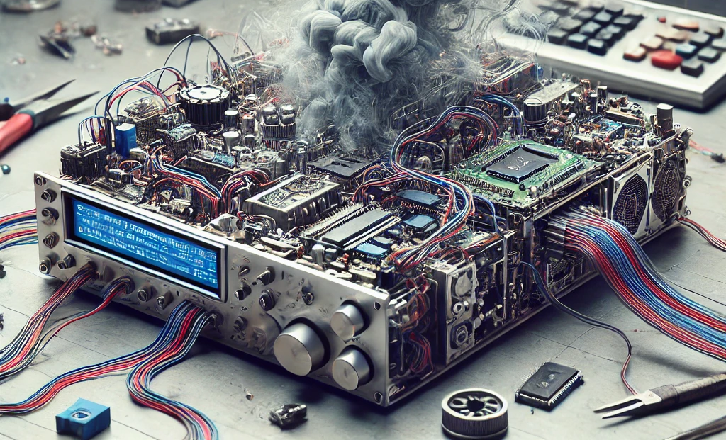
Prototypes
Not always needed, but… a good idea.
Better to fix once than need to bodge on 100 badges
I suggest you hand it off to someone bad with electronics to see if fails

Slide 8
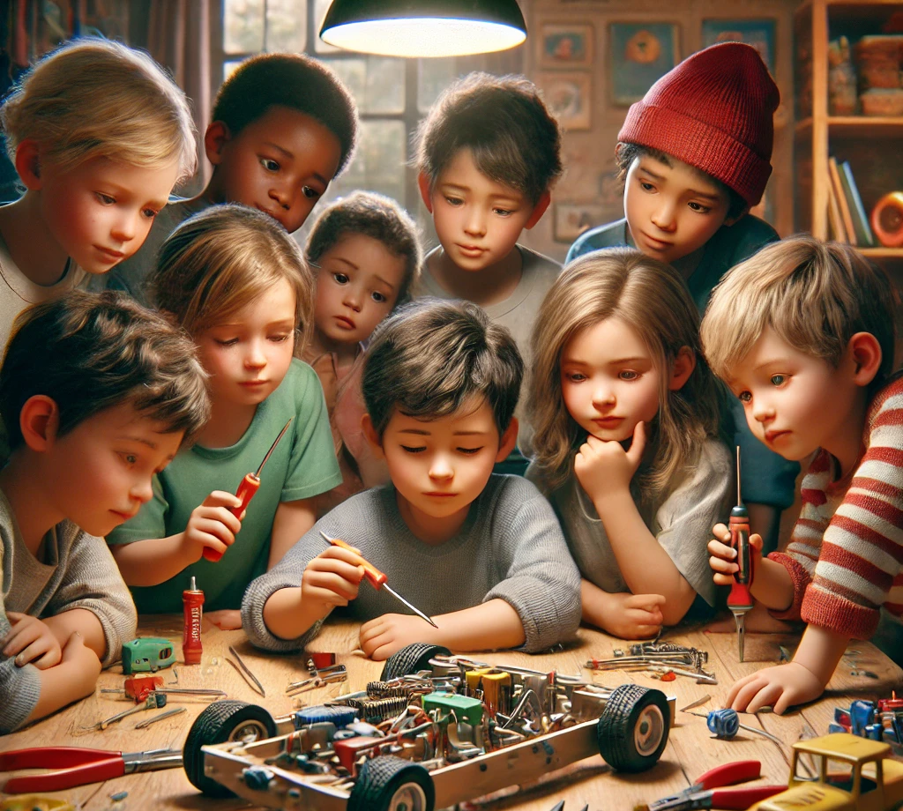
Can you build it?
It always looks bigger on your computer
Can you actually fit your screwdriver in there?
Are you violating the laws of physics?

Slide 9
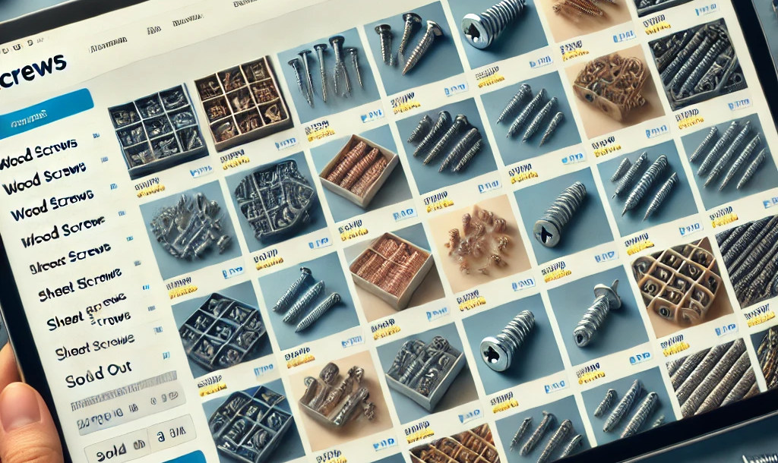
Buying parts
Can you buy the needed parts?
What does the lead time look like?
Are the prices actually reasonable?

Slide 10
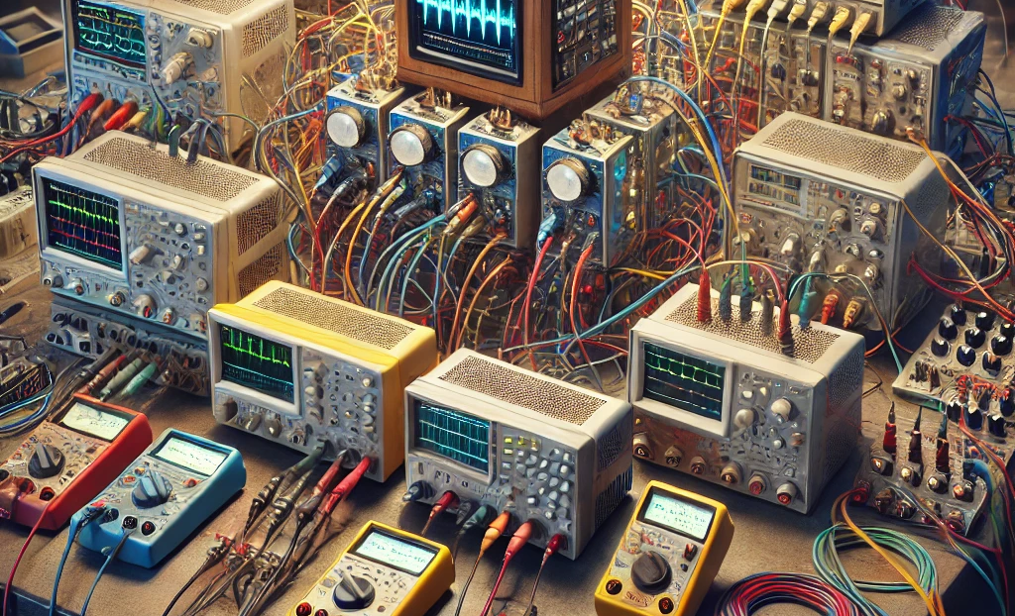
Is it testable?
If a badge has an issue, can you poke at it to fix it?
Can you create software smart enough to test the device?
Consider adding a test mode to a bootloader
What if you need to hand solder a part, can you reach the pads?

Slide 11
Production Planning
Do you really need 1000 units

Slide 12
Production Planning
How many badges do you plan to build?
Economies of scale sometimes gives you things like 50 is $100 but 75 is $110
Is there a market for all these badges?
How much work are you planning to do yourself?
Math time – if it takes you 30 minutes to build one badge, and Defcon is in a week, can you really make it happen?
Don’t spend the con in your hotel room desperately trying to finish

Slide 13



Build Quantity Selector
<50
Easy to build at home
Costly to have made
75-200
You hate having free time
Paying for assembly might be a good idea
200+
I hope you have some friends you can sucker
Really, consider paying for assembly

Slide 14
Manual Labor
Some amount of the badge build will have to be done by you or your team
Consider what this looks like
Organization is the key to keep this from becoming hell
Final Assembly
Stuffing Bags/Boxes
Labeling

Slide 15
Small Runs
Are you organized?
Buy some bins
Clean up some space for your assembly line
Do you have good tools?
A crappy iron doesn’t get better 100 badges in
Consider getting specialty tools to make your life easier
Do you have good materials?
Fresh solder paste?
Labeled parts in the right quantity?

Slide 16
Small Runs
Aim for gating items
Solder all the boards
Test all the boards
Assemble all the boards
It’s easier to not make mistakes if you do the same thing 100 times
Reward yourself when you complete gates
Afternoon off
Go watch a movie
Get some sleep (!)

Slide 17
Medium Runs
Find some friends or a local hacker group
Organization is key
Everyone gets a small job and hands to the next person
Try to have build days that get as much done as possible
Easier to get the gang together for a long assembly rather than consistently getting a large group together
Make sure your workers have incentives
I mean, if you want to do this again with your friends
Food is always welcome

Slide 18
Medium Runs
Find cost effective ways to get your vendors to do work for you
Maybe that PCBA service isn’t so expensive
Be mindful of shipping and lead times

Slide 19
Big Runs
Try to covert money into time
How much can your board house do for you?
You’re still going to need some friends
Consider how much space parts will take up
Have staging areas for all the boxes that is out of the way

Slide 20
Big Runs
Tons of parts are overwhelming
Organization continues to be key
How are you going to handle the assembled items?

Slide 21
Working With Vendors
China says delay one day

Slide 22
Keys to Good Vendor Interactions
Does your vendor have good documentation on what they can deliver?
Is it clear what you need to provide to get a good product from them?
Did you design for manufacturing?
Do their support lines lead to humans?

Slide 23
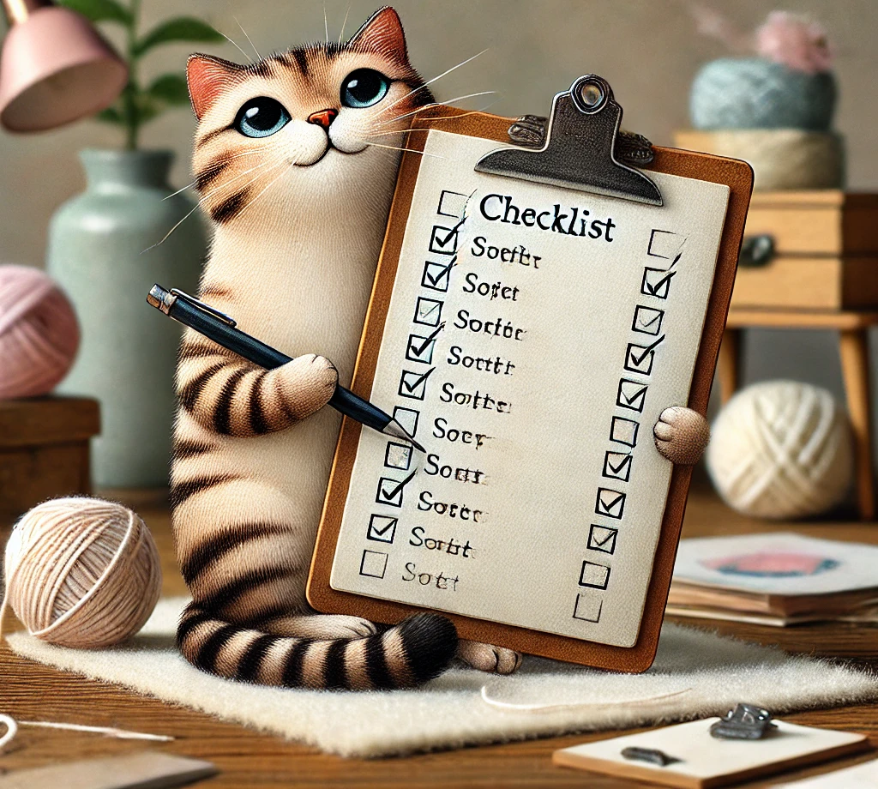
Design for Manufacturing
Use resources from your vendor to determine file formats
Make sure you are designing within their capabilities
If it’s ‘wacky’ don’t expect it to be manufacturable for cheap

Slide 24
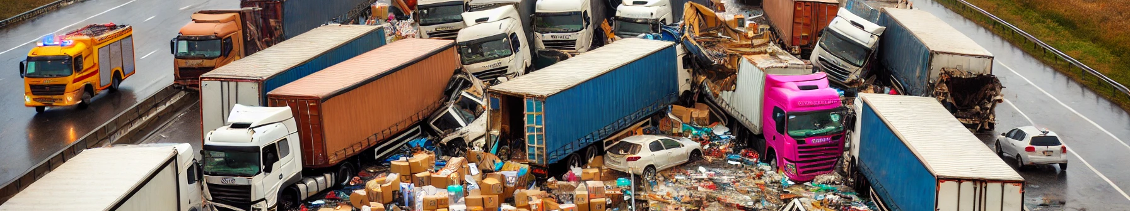
Delays
Prepare for the unexpected
What happens if your vendor does not deliver on time?

Slide 25
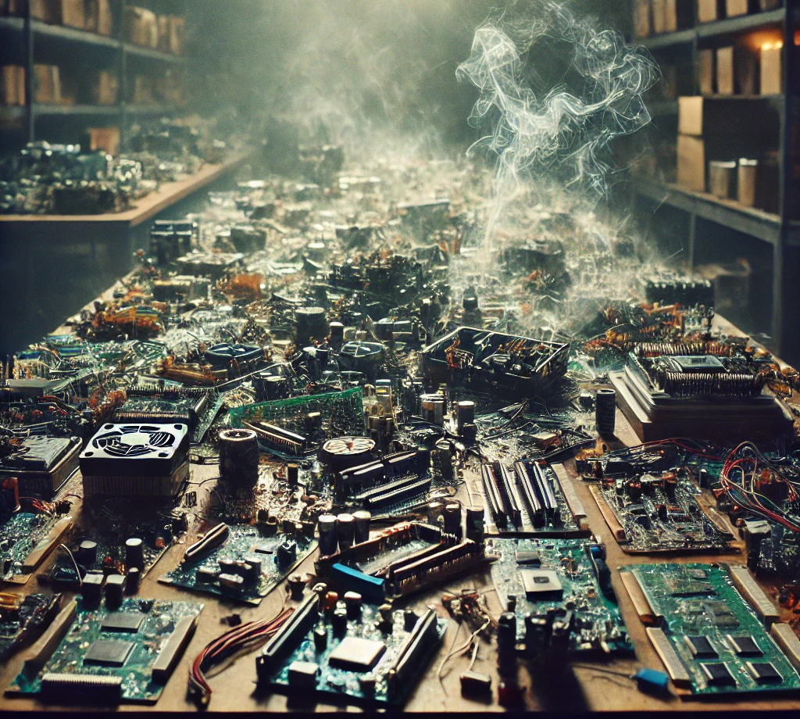
Quality
What happens if your vendors deliver bad quality?
Can you fix it, or recover?

Slide 26
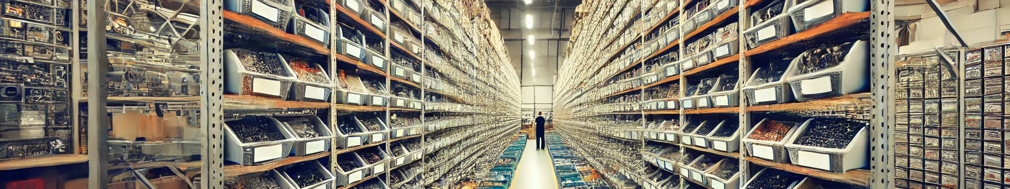
Parts Sourcing Options
Let the factory source the parts
Quality could be questionable
Likely best bet for getting the parts on time
Send the factory the parts
Shipping can be a pain
Factory might not be setup to work with your parts
Some combination
You may end up having to stuff some parts yourself

Slide 27

Costing
Often unit cost is not linear as quantity goes up
Don’t get greedy!

Slide 28

Prototypes Save Money
Before committing to a large run, sample and prototype
Budget this into your run
Some fabs won’t let you make big orders until you run a proto run!

Slide 29
Testing
It worked on my computer

Slide 30
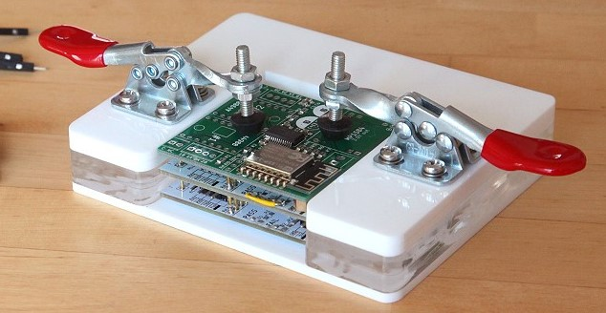
Planning for Testing
Consider adding test points that are easy to locate and connect to
Consider creating a jig for programming and testing
A test plan helps with keeping your sanity

Slide 31
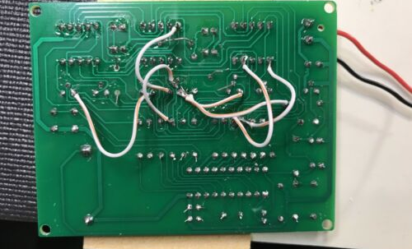
Bodges
Can you cut and jump issues?
What happens if you need to scrap part of a run, do you have time?

Slide 32

Automated Testing
Try to always have a system test mode
Test each part of the system in turn
Tests should try to be independent
Ship the test mode!

Slide 33
Packaging
Static bags or laser cut foam?

Slide 34
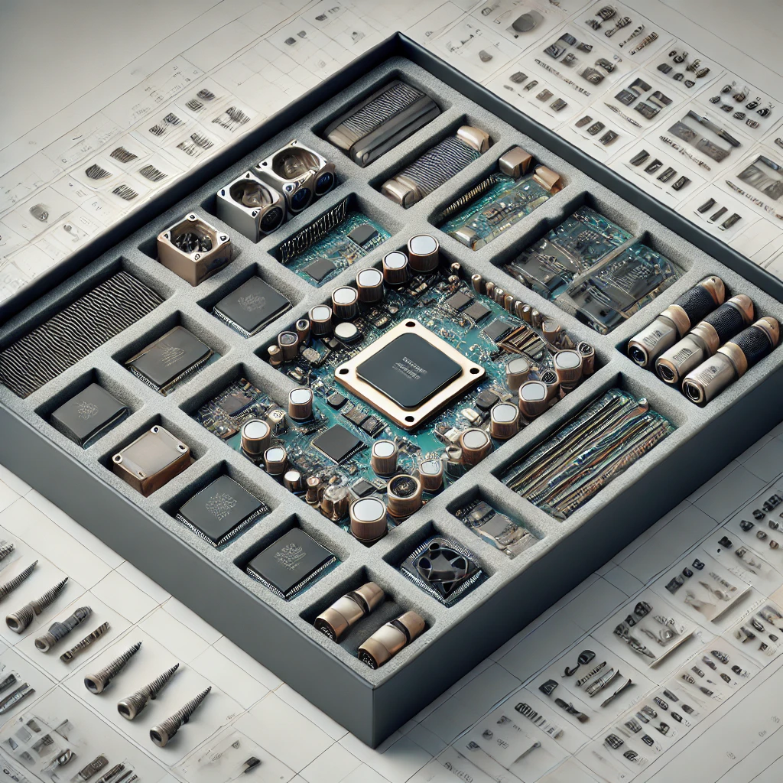
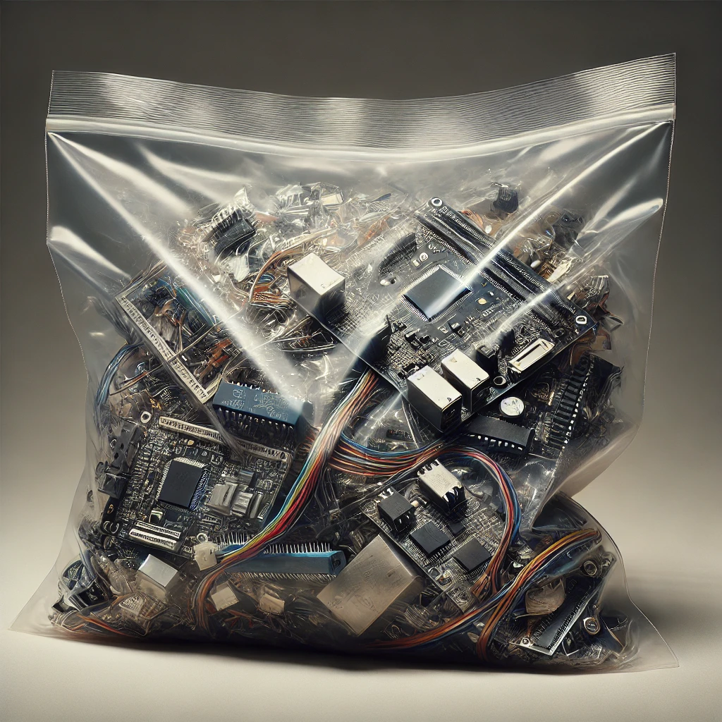
Cost vs Presentation
The WOW factor
The CHEAP factor

Slide 35
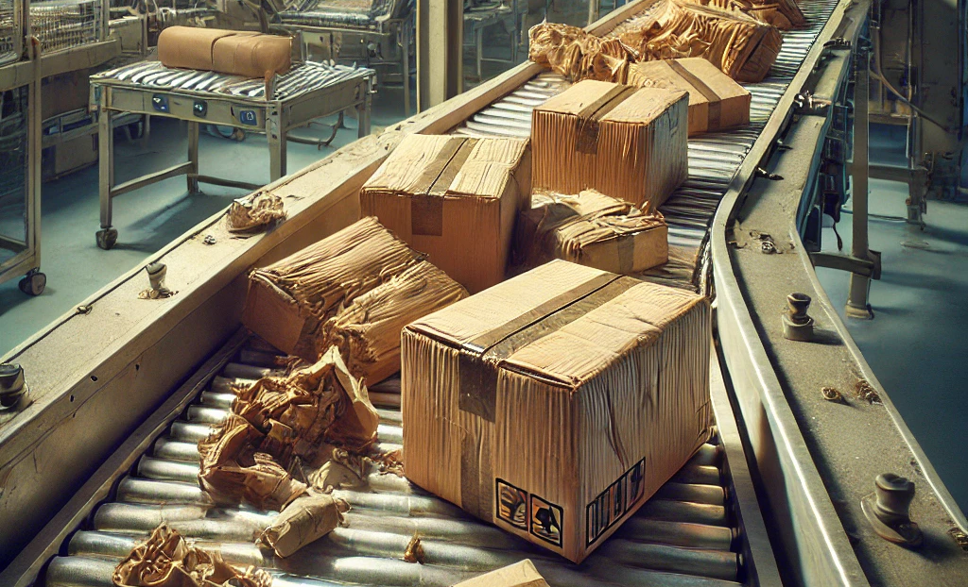
Packaging and Shipping
Can you slap a label on it and ship it?
Will it need more packaging before it can get to the end user?

Slide 36
Selling
Slinging badges out of a backpack

Slide 37

Selling Badges
Sell via a marketplace?
Sell via your own website?
Sell via a trench coat near the pool?

Slide 38
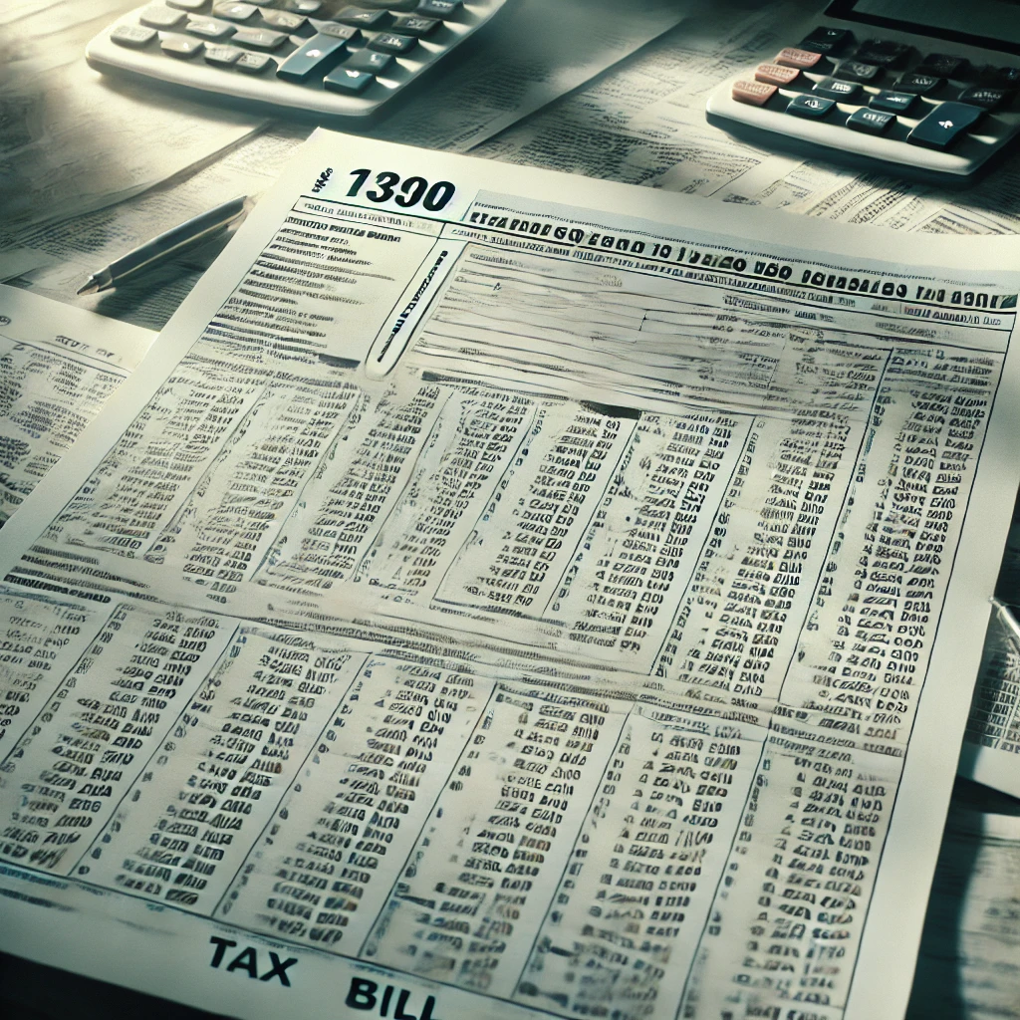
Taxes
Do you need to collect taxes?
Are you sure?

Slide 39

Returns and Angry Customers
What did you promise vs what did you deliver?
If a customer breaks it, will you fix it?

Slide 40
Thinking for the Future
Next year will be awesome

Slide 41

After Action Reports
What worked and what did not?
Take notes, keep those notes
Next year is always better!

Slide 42
Questions?
@hamster on Twitter
github.com/hamster
pcbhamster on Discord

